Slide 1
IOT PROJECT TITTLE :- GAS detection alarm system
GROUP 7
Abhay Kapoor Sahini | 20BCS3135
Gurmeet Singh | 20BCS3117
Ishant Shukla | 20BCS3152
Karanvir Singh | 20BCS3154

Slide 2
PROBLEM STATEMENT
Home fires have been taking place frequently and the threat to human lives and properties is growing in recent years. Liquid petroleum gas (LPG) is highly inflammable and can burn even at some distance from the source of leakage. Therefore, developing the gas leakage alert system is very essential.
In this project we will use a gas sensor to detect harmful gases like
LPG, CARBON MONOXIDE, METHANE AND GENERAL COMBUSTIBLE GASES.

Slide 3
objective
Detect Gas Leakage (like LPG) using MQ2 Sensor and Arduino
Flash a red light on as a sign of alert
Sound Alarm – produce sound alert on gas leak
Display status in an LCD display

Slide 4
PLANNING OF COMPONENTS
Breadboard
Resistors
LED’s – Red and green
Gas sensor – To sense LPG leakage
Arduino UNO R3
To read MQ2 output and detect gas leak
To activate output upon gas leak – led and buzzer alert
LCD Module – To display status message
Buzzer – To produce alarm sound

Slide 5
PROCEDURE
For Arduino Uno R3
For LCD display
Connect Arduino 5V to positive power rail
Connect Arduino GND to negative power rail
Connect Arduino A0 to gas sensor B1
Connect gas sensor A1, H2, A2 to positive power rail
Connect gas sensor H2 to ground
Connect gas sensor B2 to 4.7k ohms resistor, then to ground
Connect piezo positive terminal to Arduino pin 4
Connect piezo negative terminal to 1k ohms resistor, then to ground
Connect the cathodes of the two LEDs to 221 ohms resistor, then to ground
Connect the anode of the red LED to Arduino pin 2
Connect the anode of the green LED to Arduino pin 3
Connect LCD ground, contrast, and LED cathode to ground
Connect LCD anode to 1k ohms resistor, then to the positive power rail
Connect LCD power to the positive power rail
Connect LCD register select to Arduino pin 5
Connect LCD read/write to ground
Connect LCD enable to Arduino pin 6
Connect LCD terminal 4,5,6,7 to Arduino pin 8,9,10,11 respectively.

Slide 6
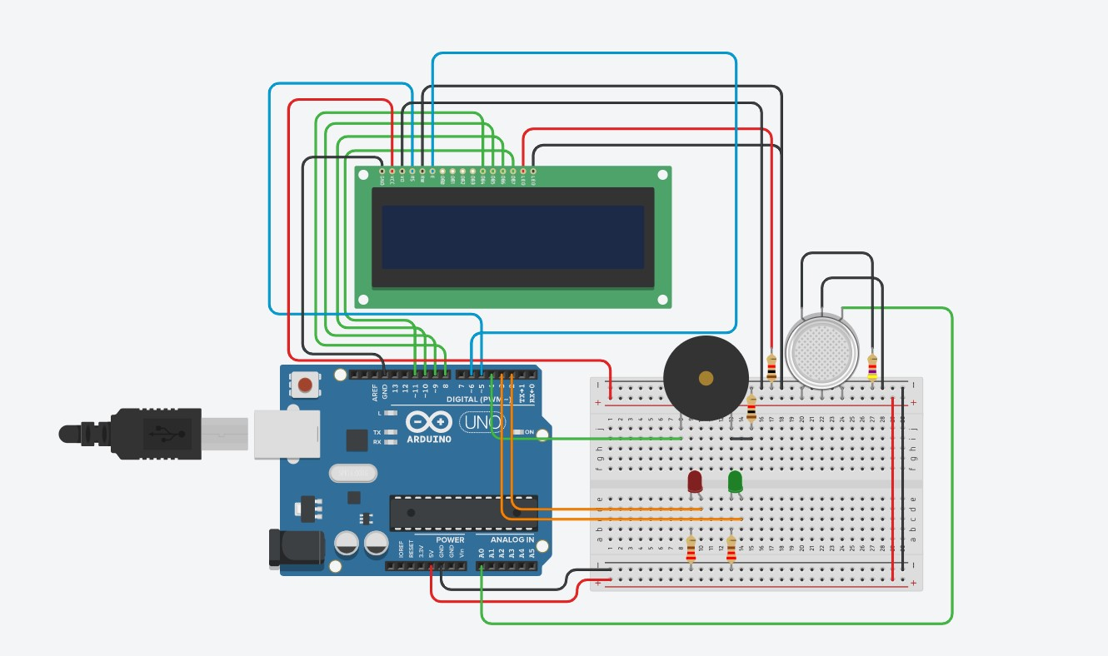
Tinkercad - CIRCUIT DIAGRAM

Slide 7
ARDUINO UNO R3 CODE
#include <LiquidCrystal.h>
LiquidCrystal lcd(5,6,8,9,10,11);
int redled = 2;
int greenled = 3;
int buzzer = 4;
int sensor = A0;
int sensorThresh = 400;
void setup()
{
pinMode(redled, OUTPUT);
pinMode(greenled,OUTPUT);
pinMode(buzzer,OUTPUT);
pinMode(sensor,INPUT);
Serial.begin(9600);
lcd.begin(16,2);
}
void loop()
{
int analogValue = analogRead(sensor);
Serial.print(analogValue);
if(analogValue>sensorThresh)
{
digitalWrite(redled,HIGH);
digitalWrite(greenled,LOW);
tone(buzzer,1000,10000);
lcd.clear();
lcd.setCursor(0,1);
lcd.print("ALERT");
delay(1000);
lcd.clear();
lcd.setCursor(0,1);
lcd.print("EVACUATE");
delay(1000);
}
else
{
digitalWrite(greenled,HIGH);
digitalWrite(redled,LOW);
noTone(buzzer);
lcd.clear();
lcd.setCursor(0,0);
lcd.print("SAFE");
delay(1000);
lcd.clear();
lcd.setCursor(0,1);
lcd.print("ALL CLEAR");
delay(1000);
}
}

Slide 8
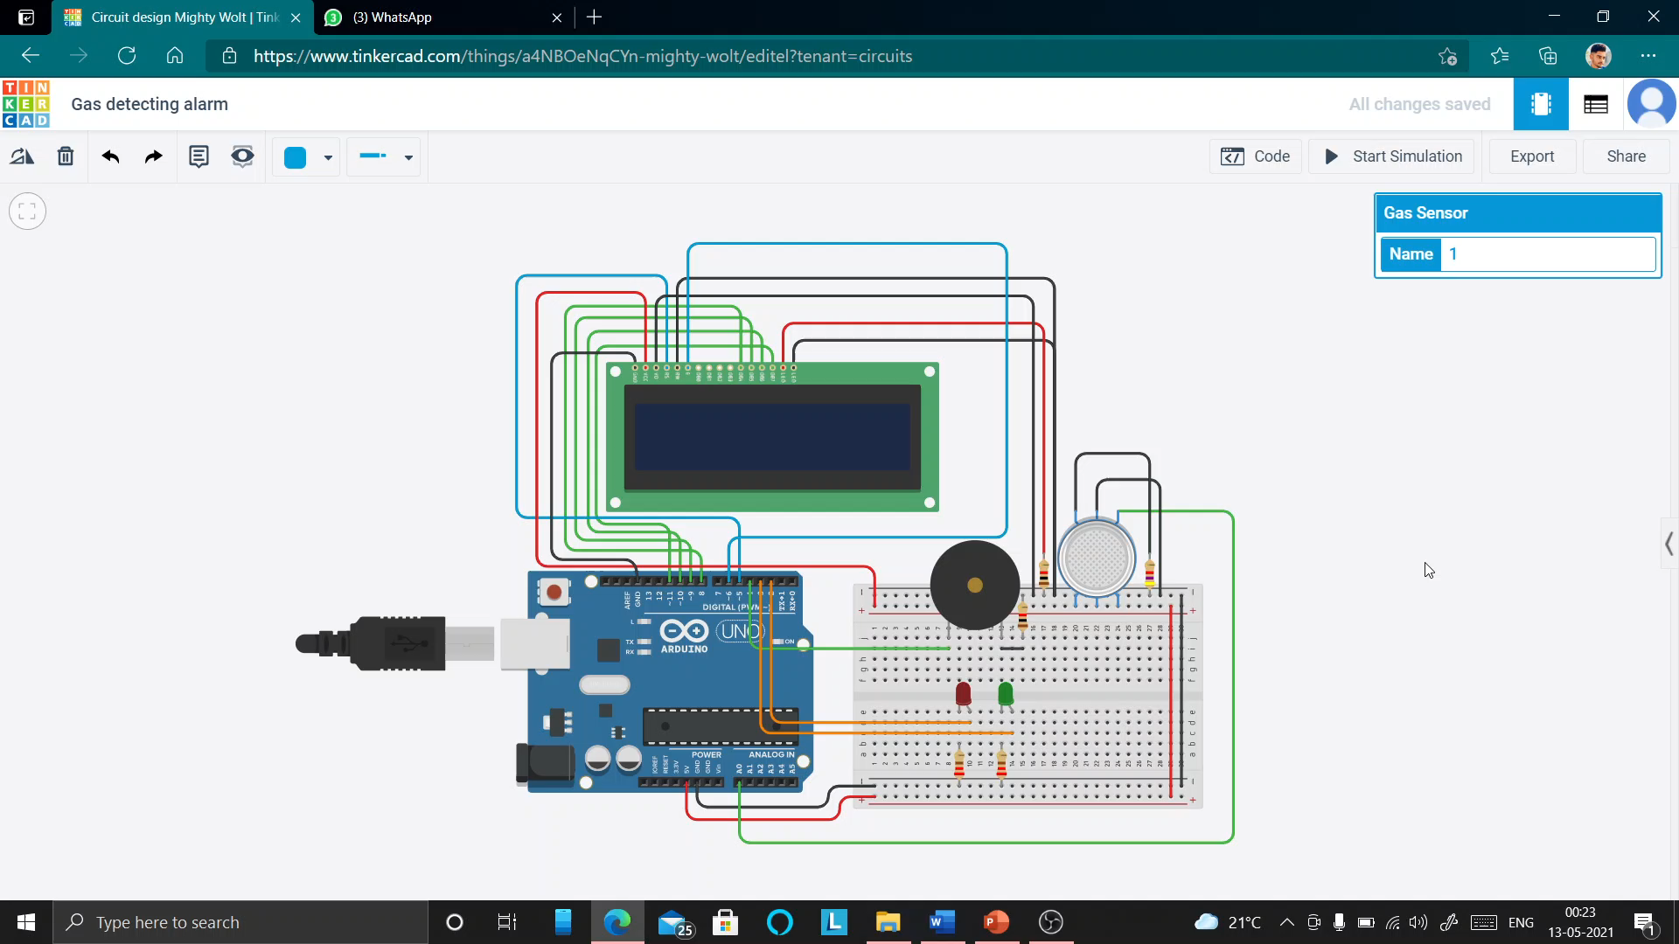
RESULT – video of working

Slide 9
CONCLUSION
Gas leakage leads to severe accidents resulting in material losses and human injuries. Gas leakage occurs mainly due to poor maintenance of equipment and inadequate awareness of the people. Hence, LPG leakage detection is essential to prevent accidents and to save human lives. This system triggers LED and buzzer to alert people when LPG leakage is detected. This system is very simple yet reliable.
Improvement/ Additional feature – We can also include a GSM Module for communication and to send SMS to mobile numbers whenever there is a gas leakage.

Slide 10
WORK DISTRIBUTION
Abhay - The idea of this project and the synopsis part
Karanvir - Circuit diagram and the simulation part
Ishant - PPT(all writing and designing part)
Gurmeet - Arduino and coding part

Slide 11
Thanks!
Any questions?

